Slide 1





Raspberry Pi GPIO
All Rpi GPIO interaction is setup using Python language
water_system.py
start_pump.py
cleanup.py

Slide 2

Raspberry Pi Webserver
To run Rpi remotely, webserver setup is needed
There are several choices of webserver available
This project using : Apache + PHP

Slide 3
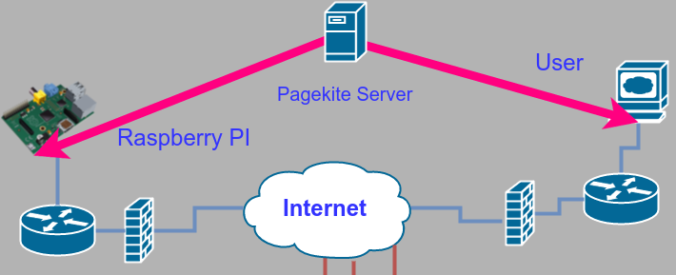
Access Raspberry Pi via Remotely
Webserver setup in Rpi can be publish to the internet for remote access
This project use PageKite as the server to create accessible domain for user

